Slide 1
Distillation as a Defense to Adversarial Perturbations against Deep Neural Networks Nicolas Papernot, Patrick McDaniel, Xi Wu, Somesh Jha, Ananthram Swami (37th IEEE Symposium on Security & Privacy, IEEE 2016. San Jose, CA.)
Presented By
Anjana Tiha

Slide 2
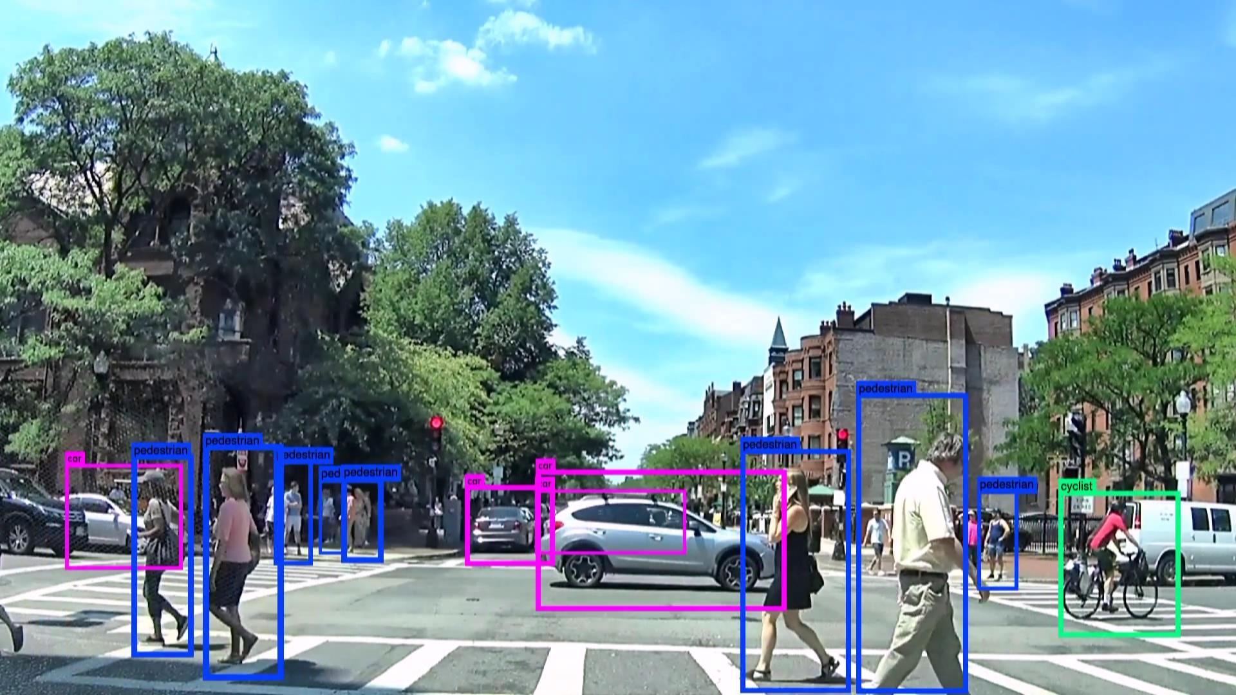
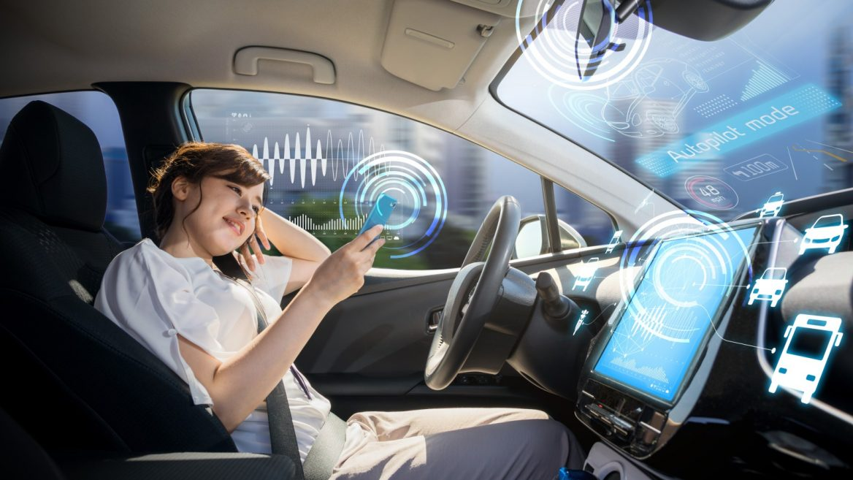
Application of Deep Learning (Self Driving Car)

Slide 3
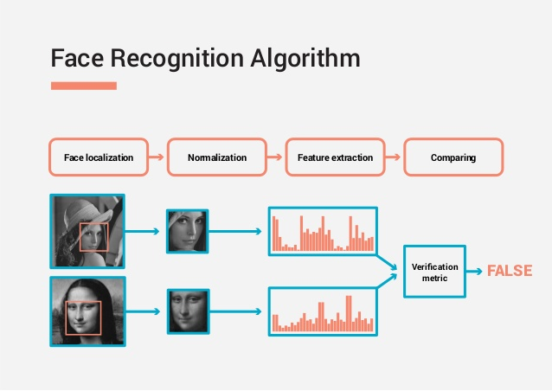
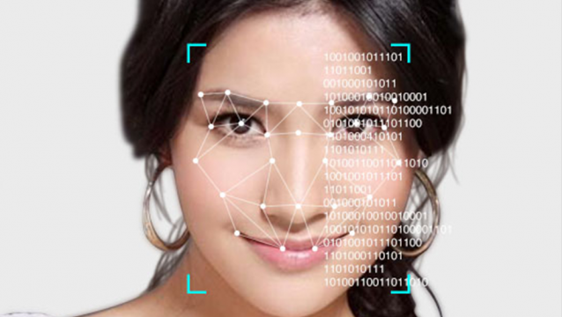
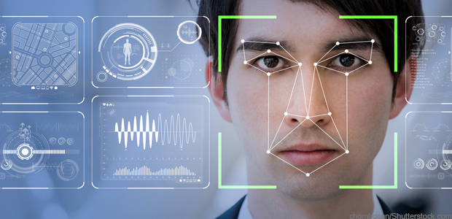
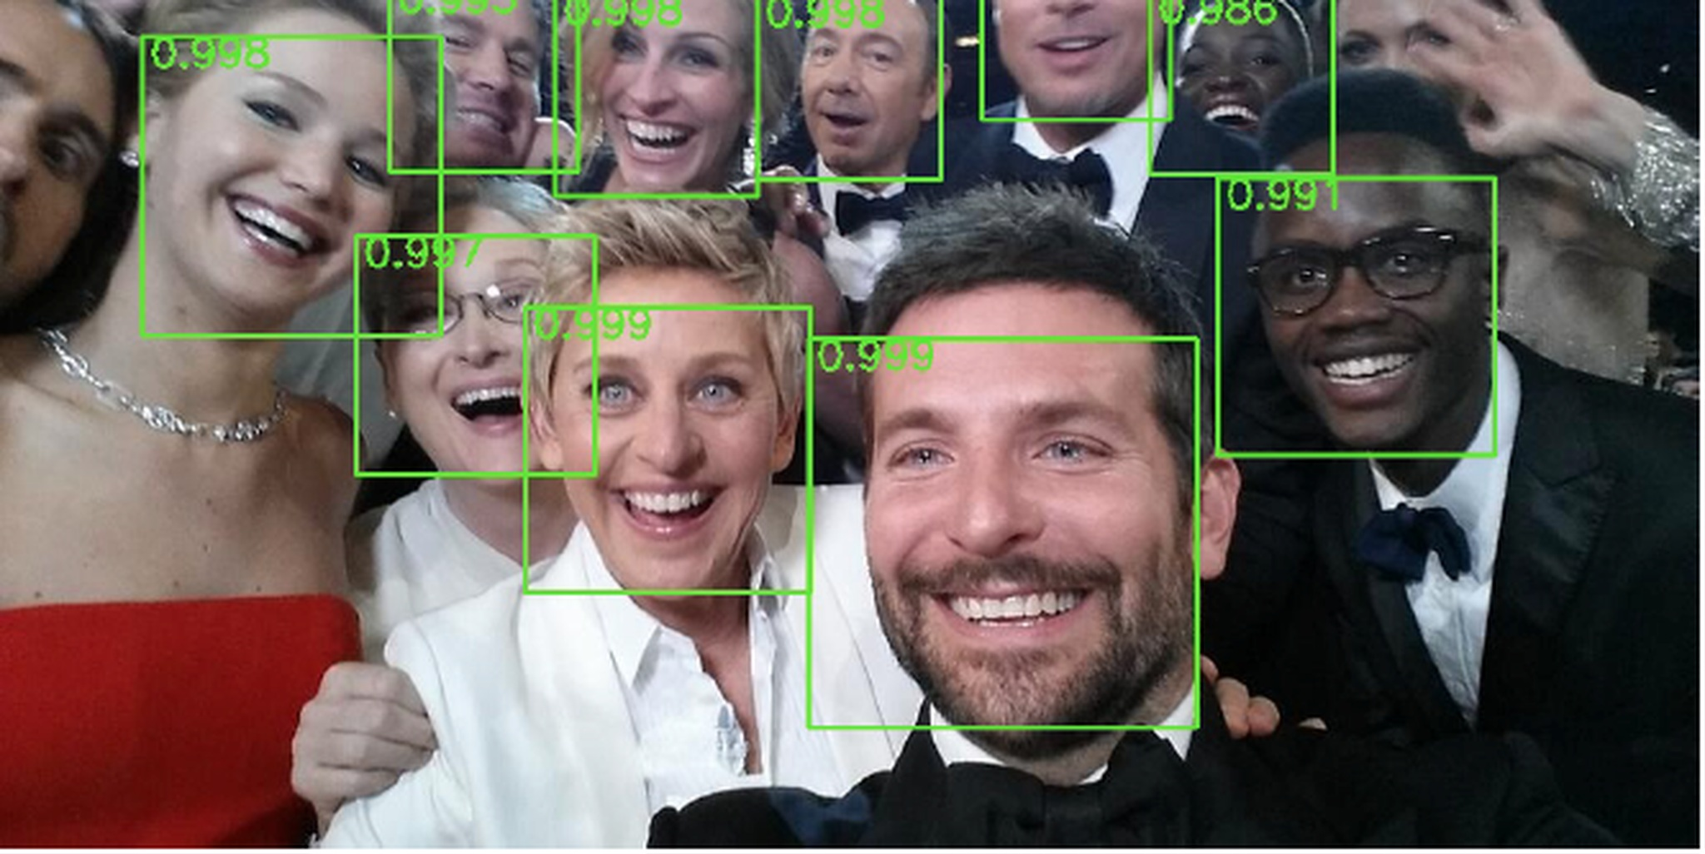
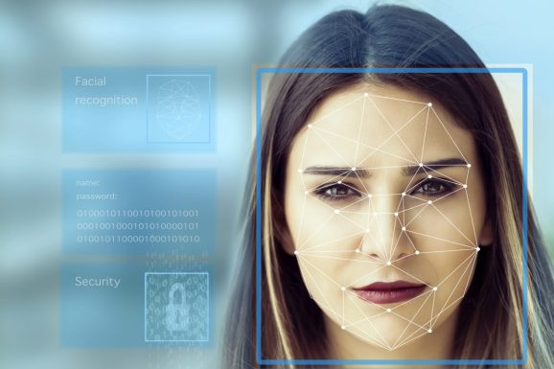
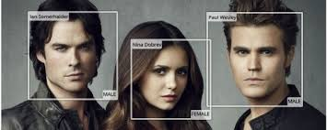
Application of Deep Learning (Identity Verification)

Slide 4
Effect of Adversarial Perturbations against Deep Neural Networks
Autonomous Driving:
Fails to detect living objects
Fails to detect other vehicles
Identity Verification
Captcha detection can fail to function
Malicious input data sample that over identifies digits, letters
Fails detecting unauthorized face
Gives unauthorized access
Fails to raise fraudulent transaction
Identifies anomalous transaction as safe

Slide 5
Deep Neural Network
Convolutional Neural Network
Object Detection
Self Driving car, Identity Verification
Recurrent Neural Network
Series Data Processing
Text Summarization, Dialogue Generation
Deep Reinforcement Learning
Reward Based Deep Learning System

Slide 6
Deep Learning
Input Layer
Weight, bias
Hidden Layer
Multiple layers
Composed of Neurons
Neurons has own weight and universal activation function
Activation Functions – sigmoid, tangent
Output Layer
Produces output
SoftMax function

Slide 7
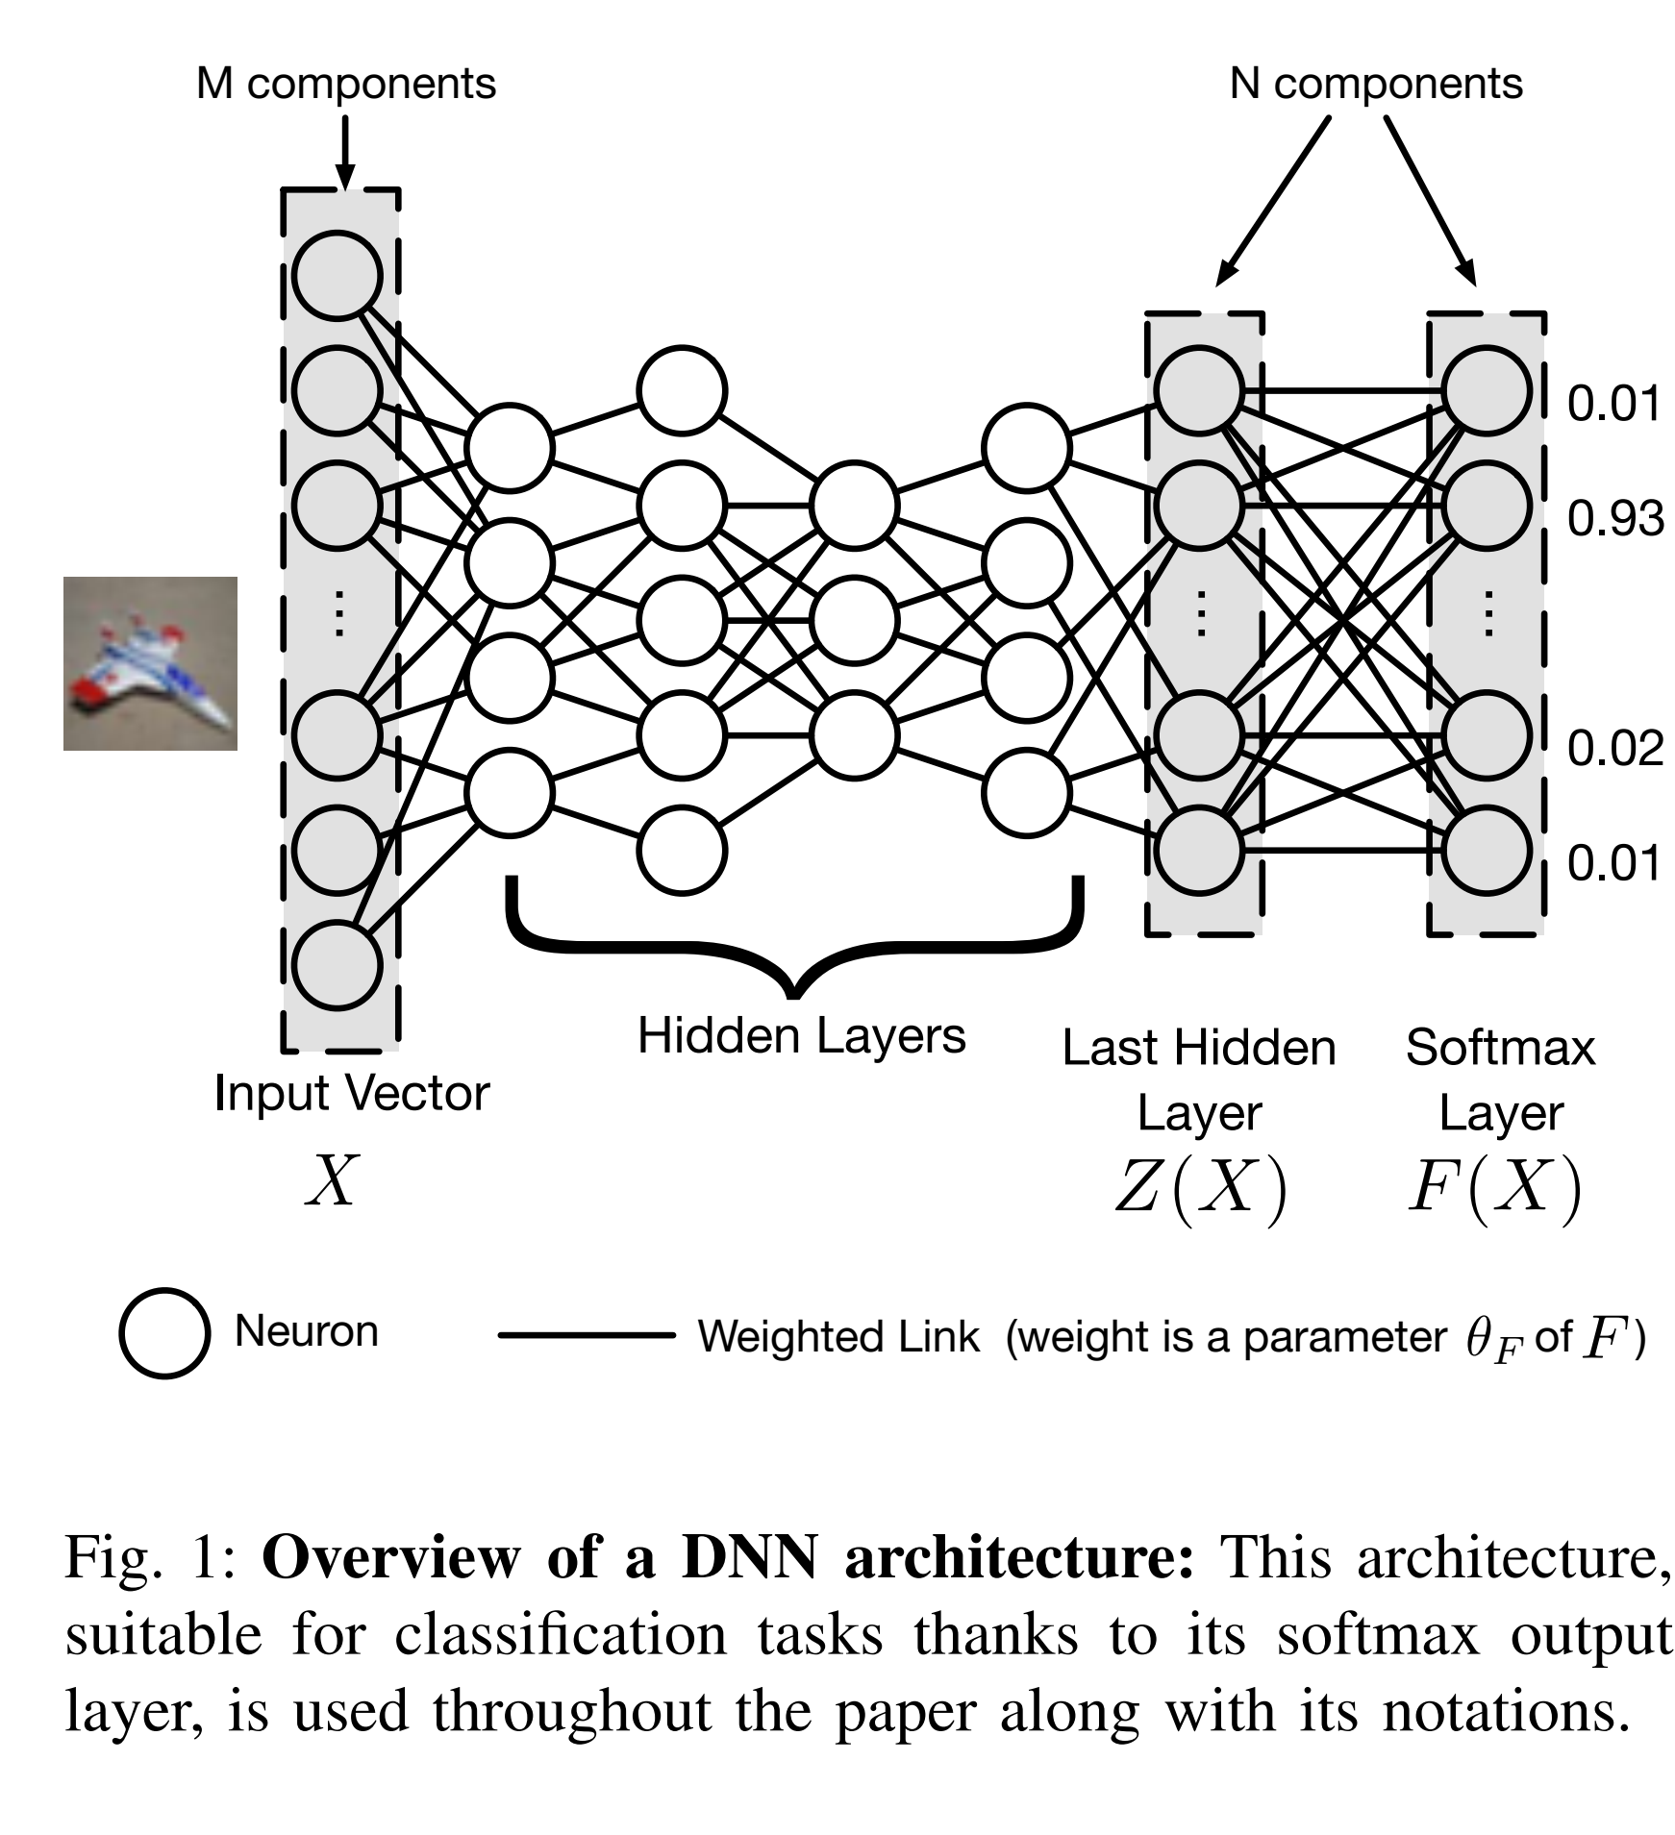
Deep Neural Network

Slide 8
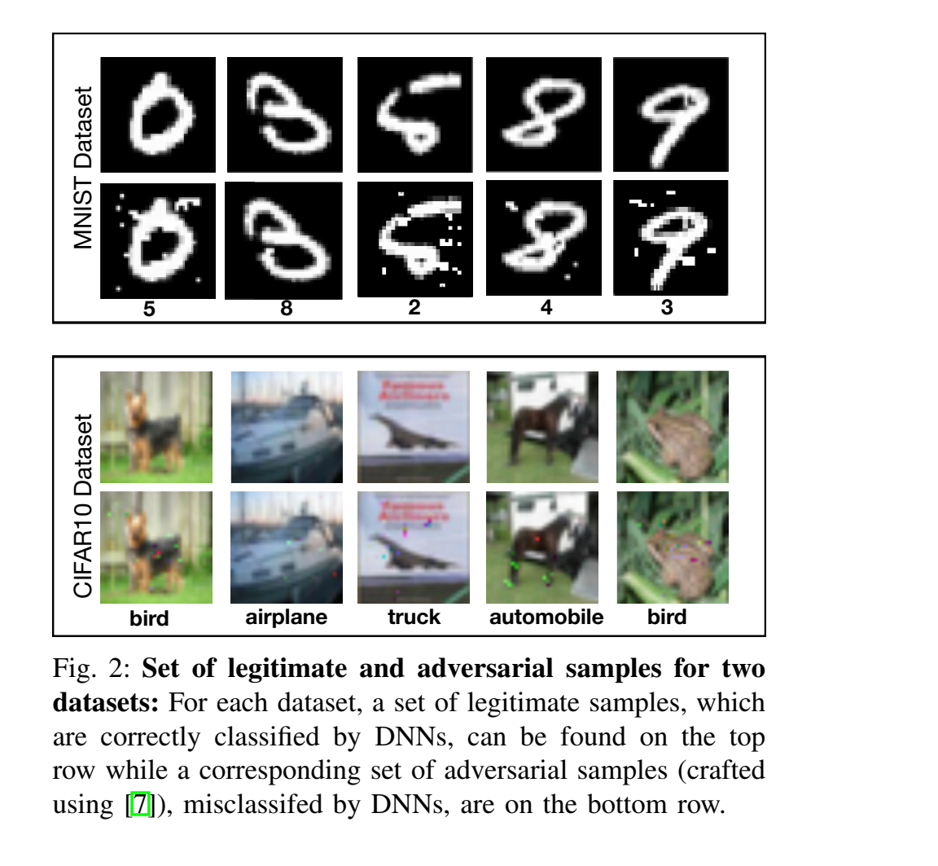
Deep Neural Network Misclassified Objects (MNIST and CIFAR Dataset)

Slide 9
Adversarial Input Crafting
The adversarial sample crafting is then a two-step process:
Direction Sensitivity Estimation
evaluate the sensitivity of class change to each input feature
Perturbation Selection
use the sensitivity information to select a perturbation X among the input dimensions

Slide 10
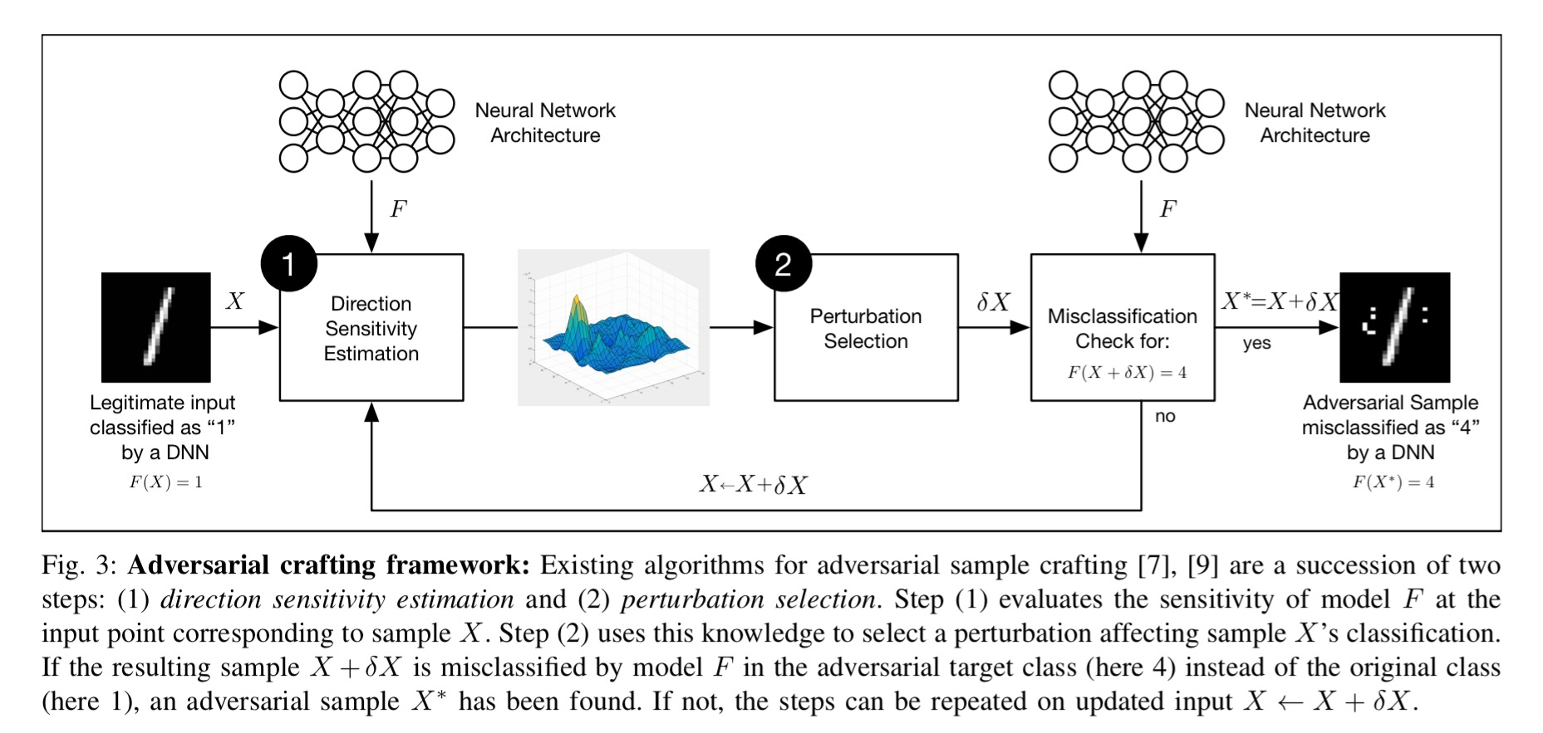
Adversarial Input Crafting

Slide 11
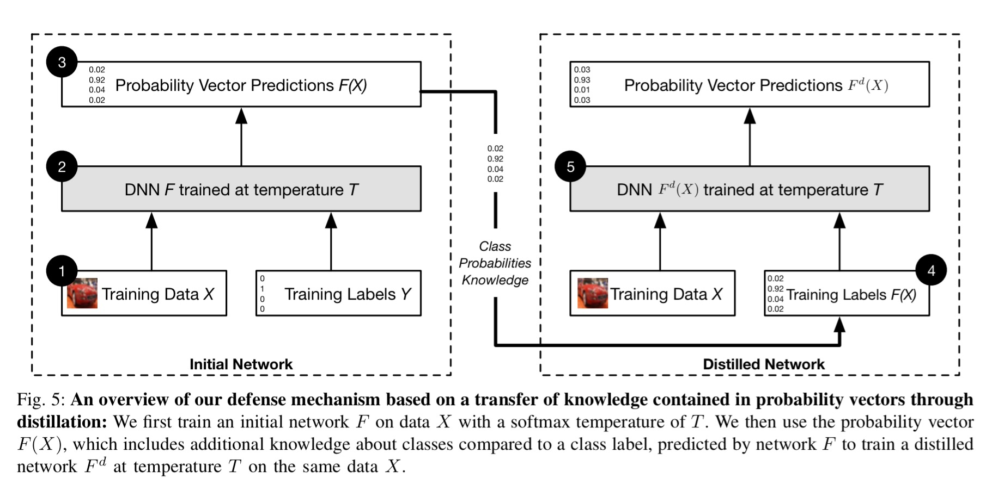
Neural Network Distillation

Slide 12
Datasets
MNIST Dataset
70, 000 black and white images of handwritten digits.
each pixel is encoded as a real number between 0 and 1.
split between a training set of 60, 000 samples and a test set of 10, 000.
classification goal is to determine the digit written.
classes therefore range from 0 to 9.
CIFAR10 Dataset
60, 000 color images.
Each pixel is encoded by 3 color components.
split between a training set of 50, 000 samples and a test set of 10, 000 samples.
classified in one of the 10 mutually exclusive classes.
airplane, automobile, bird, cat, deer, dog, frog, horse, ship, and truck.

Slide 13
Evaluation of Performance
Metric | First DNN | Second DNN
Success rate of adversarial crafting | 95.89% -----> 0.45% | 87.89% -----> 5.11%
Accuracy variability between models trained with/out distillation | smaller than 1.37% | smaller than 1.37%
distillation increases robustness | 790% | 556%

Slide 14
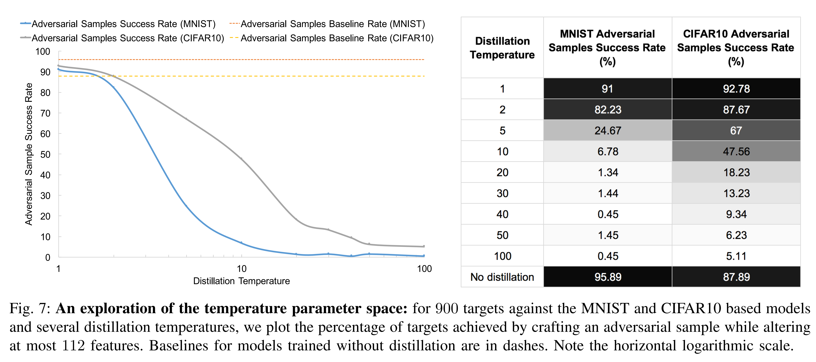
Performance for Temperature

Slide 15
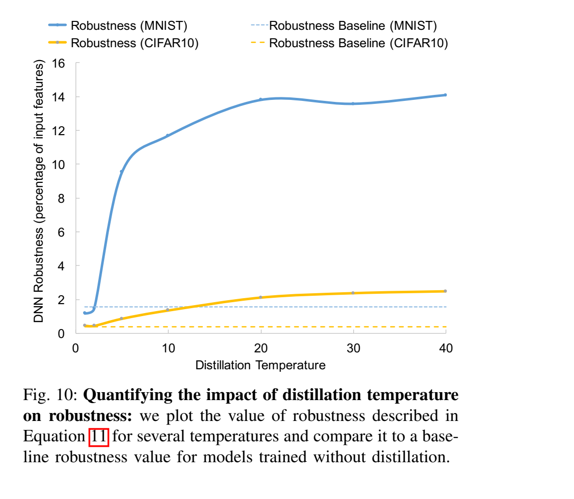
Robustness

Slide 16
Conclusion
Paper has empirically shown that using Neural Distillation for Deep Neural Network training can
reduces target class adversarial attack
generalizes model better
Neural Distillation
smoothens the gradient
reduces gradient amplitude variation for malicious input
Still Neural Distillation process can not be perfect for DNN
diversity of DNN
needs more elaborate experimentation on diverse dataset

Slide 17
Reference
Papernot N, McDaniel P, Wu X, Jha S, Swami A. Distillation as a defense to adversarial perturbations against deep neural networks. InSecurity and Privacy (SP), 2016 IEEE Symposium on 2016 May 22 (pp. 582-597). IEEE.
https://arxiv.org/pdf/1511.04508.pdf
MNIST Database http://yann.lecun.com/exdb/mnist/
CIFAR Dataset https://www.cs.Toronto.edu/~kriz/cifar.html

Slide 18
Image Credits
https://mms.businesswire.com/media/20170118005301/en/564975/5/Neurala_AutoRecognition-03.jpg
https://www.israel21c.org/wp-content/uploads/2017/07/shutterstock_autodrive-1168x657.jpg
https://gcn.com/~/media/GIG/GCN/Redesign/Articles/2017/November/facialrecognition2.png
https://venturebeat.com/wp-content/uploads/2018/02/istock-892452254-e1518725081538.jpg?fit=578%2C385&strip=all
https://kintronics.com/wp-content/uploads/2017/04/faciial-recognition-gorl.png
https://encrypted-tbn0.gstatic.com/images?q=tbn:ANd9GcQtqB4Uw6RRwmSEiUKpaLqASTB34jcDlR-eImQ1hogTvqiGxXuO4Q
https://image.slidesharecdn.com/py4esxdtx6kxv6jqwyya-signature-711b949ae17ca4b3b3df0beb7e6cee93146c5e735f2ba5d5386d854da73fcb5d-poli-151016121258-lva1-app6891/95/face-recognition-based-on-deep-learning-yurii-pashchenko-technology-stream-8-638.jpg?cb=1445257430
https://image.slidesharecdn.com/dlcvd3l5faces-160803160904/95/deep-learning-for-computer-vision-face-recognition-upc-2016-6-638.jpg?cb=1470241879
https://www.dailydot.com/wp-content/uploads/7da/6e/fc3aa93d4cf68ff5406f291efcd81b08.jpg
http://visagetechnologies.com/uploads/2015/09/blog-multimodal1.jpg

